Slide 1
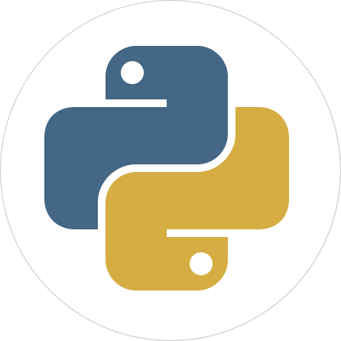
Programming with Python
Chapter 5

Slide 2
Lists and Dictionaries
A list allows the programmer to manipulate a sequence of data values of any types
A dictionary organizes data values by association with other data values rather than by sequential position
Lists and dictionaries provide powerful ways to organize data in useful and interesting applications

Slide 3
Lists
List: Sequence of data values (items or elements)
Some examples:
Shopping list for the grocery store
Guest list for a wedding
Recipe, which is a list of instructions
Text document, which is a list of lines
Words in a dictionary
Each item in a list has a unique index that specifies its position (from 0 to length – 1)

Slide 4
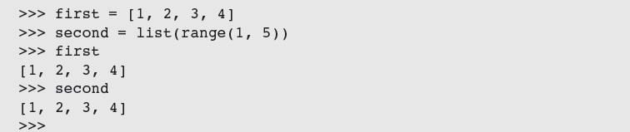
List Literals and Basic Operators
Some examples:
['apples', 'oranges', 'cherries']
[[5, 9], [541, 78]]
When an element is an expression, its value is included in the list:
Lists of integers can be built using range:

Slide 5
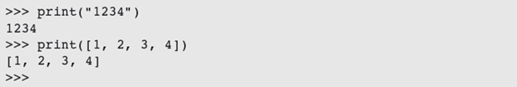
List Literals and Basic Operators
len, [], +, and == work on lists as expected:
To print the contents of a list:
in detects the presence of an element:

Slide 6
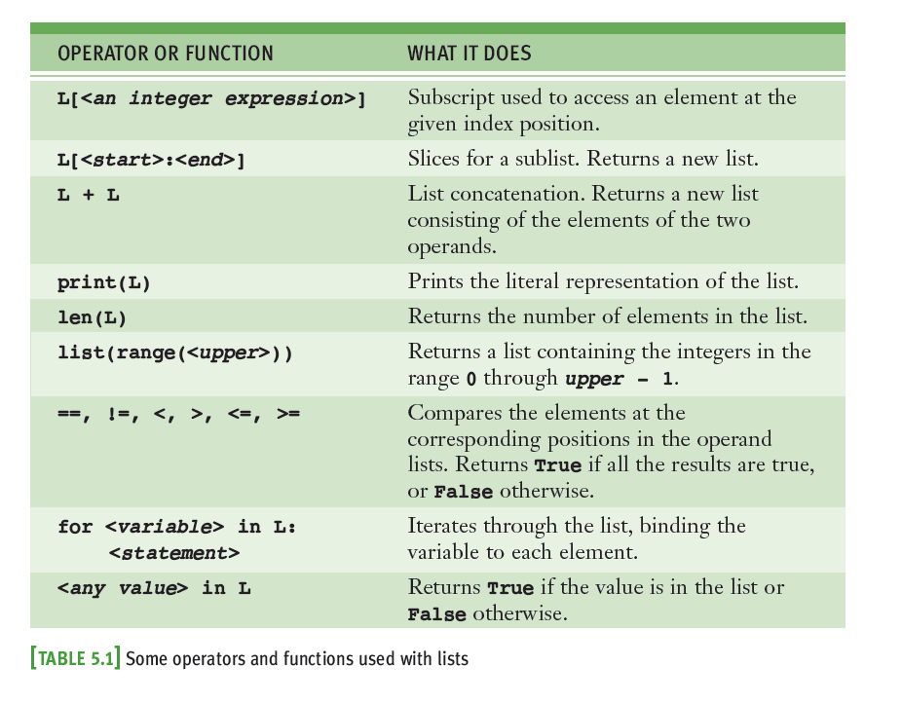
List Literals and Basic Operators

Slide 7
Replacing an Element in a List
A list is mutable
Elements can be inserted, removed, or replaced
The list itself maintains its identity, but its state—its length and its contents—can change
Subscript operator is used to replace an element:
Subscript is used to reference the target of the assignment, which is not the list but an element’s position within it

Slide 8
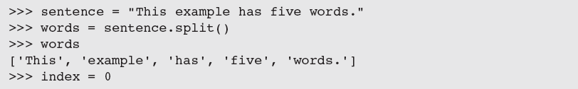
Replacing an Element in a List
Read the “while” loop code below. What does each line do?

Slide 9
List Methods for Inserting and Removing Elements
The list type includes several methods for inserting and removing elements

Slide 10
List Methods for Inserting and Removing Elements

Slide 11
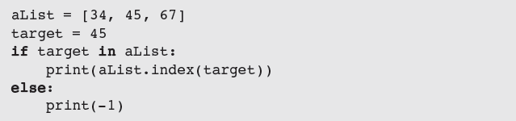
Searching a List
in determines an element’s presence or absence, but does not return position of element (if found)
Use method index to locate an element’s position in a list
Raises an error when the target element is not found

Slide 12
Sorting a List
A list’s elements are always ordered by position, but you can impose a natural ordering on them
For example, in alphabetical order
When the elements can be related by comparing them <, >, and ==, they can be sorted
The method sort mutates a list by arranging its elements in ascending order

Slide 13
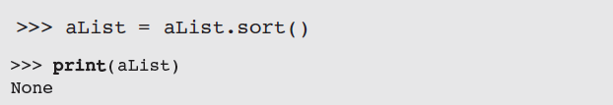
Mutator Methods and the Value None
All of the functions and methods examined in previous chapters return a value that the caller can then use to complete its work
Mutator methods (e.g., insert, append) usually return no value of interest to caller
Python automatically returns the special value None

Slide 14
Aliasing and Side Effects
Mutable property of lists leads to interesting phenomena:
first and second are aliases
(refer to the exact same list object)

Slide 15
Aliasing and Side Effects
To prevent aliasing, copy contents of object:
Alternative:

Slide 16
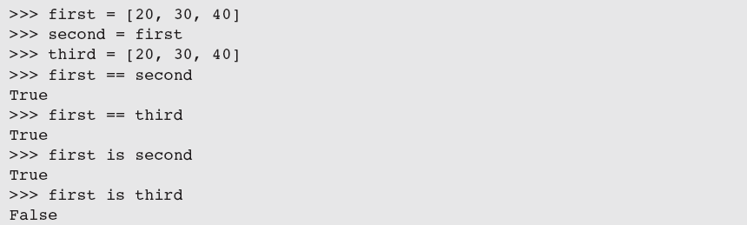
Equality: Object Identity and Structural Equivalence

Slide 17
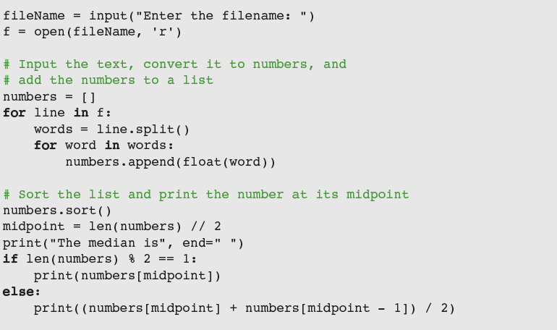
Example: Using a List to Find the Median of a Set of Numbers
To find the median of a set of numbers:

Slide 18
Tuples
A tuple resembles a list, but is immutable
Indicate by enclosing its elements in ()
Most of the operators and functions used with lists can be used in a similar fashion with tuples

Slide 19
The Syntax of Simple Function Definitions
Defining our own functions allows us to organize our code in existing scripts more effectively
Definition of a function consists of header and body
Docstring contains information about what the function does; to display, enter help(square)
A function can be defined in a Python shell, but it is more convenient to define it in an IDLE window
Syntax of a function definition:

Slide 20
Parameters and Arguments
A parameter is the name used in the function definition for an argument that is passed to the function when it is called
For now, the number and positions of arguments of a function call should match the number and positions of the parameters in the definition
Some functions expect no arguments
They are defined with no parameters

Slide 21
The return Statement
Place a return statement at each exit point of a function when function should explicitly return a value
Syntax:
If a function contains no return statement, Python transfers control to the caller after the last statement in the function’s body is executed
The special value None is automatically returned

Slide 22
Boolean Functions
A Boolean function usually tests its argument for the presence or absence of some property
Returns True if property is present; False otherwise
Example:

Slide 23
Defining a main Function
main serves as the entry point for a script
Usually expects no arguments and returns no value
Definition of main and other functions can appear in no particular order in the script
As long as main is called at the end of the script
Script can be run from IDLE, imported into the shell, or run from a terminal command prompt
What are the difference between Python’s “main” function and Java “main” method?
What is the signature of Java “main” method?

Slide 24
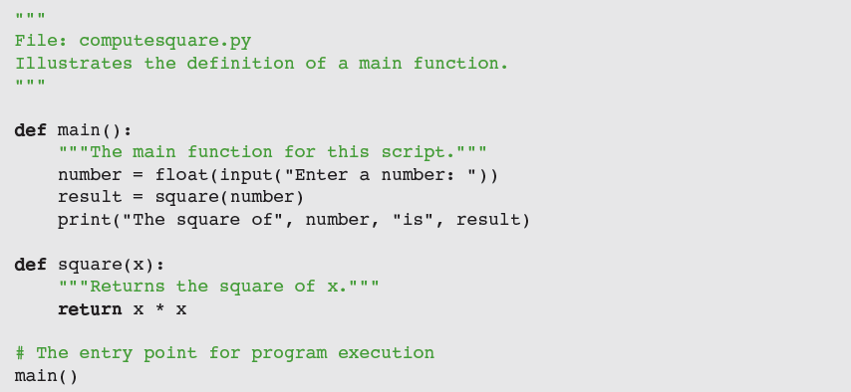
Defining a main Function

Slide 25
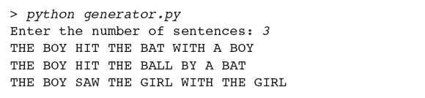
Case Study: Generating Sentences
Request: write a program that generates sentences
Analysis: program will generate sentences from a simplified subset of English

Slide 26


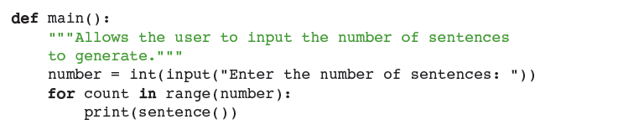
Case Study: Generating Sentences
Design:
Assign task of generating each phrase to a separate function

Slide 27
Case Study: Generating Sentences
Implementation (coding):
The variables for the data are initialized just below the import statement

Slide 28
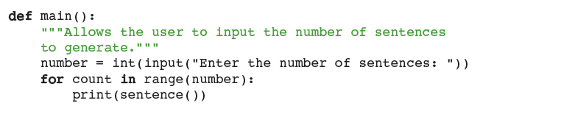
Case Study: Generating Sentences

Slide 29
Case Study: Generating Sentences
Testing:
Two approaches:
Bottom-up
Top-down
Wise programmer can mix bottom-up and top-down testing as needed

Slide 30
Dictionaries
A dictionary organizes information by association, not position
Example: When you use a dictionary to look up the definition of “mammal,” you don’t start at page 1; instead, you turn to the words beginning with “M”
Data structures organized by association are also called tables or association lists
In Python, a dictionary associates a set of keys with data values

Slide 31
Dictionary Literals
A Python dictionary is written as a sequence of key/value pairs separated by commas
Pairs are sometimes called entries
Enclosed in curly braces ({ and })
A colon (:) separates a key and its value
Examples:
{'Sarah':'476-3321', 'Nathan':'351-7743'} A Phone book
{'Name':'Molly', 'Age':18} Personal information
{} An empty dictionary
Keys can be data of any immutable types, including other data structures

Slide 32
Adding Keys and Replacing Values
Add a new key/value pair to a dictionary using []:
Example:
Use [] also to replace a value at an existing key:

Slide 33
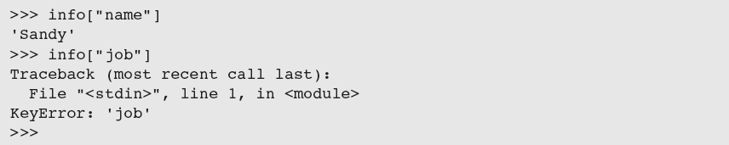

Accessing Values
Use [] to obtain the value associated with a key
If key is not present in dictionary, an error is raised
If the existence of a key is uncertain, test for it using the dictionary method has_key
Easier strategy is to use the method get

Slide 34
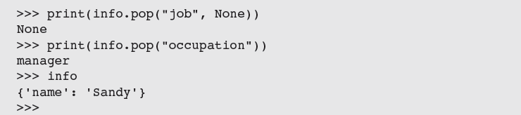
Removing Keys
To delete an entry from a dictionary, remove its key using the method pop
pop expects a key and an optional default value as arguments

Slide 35
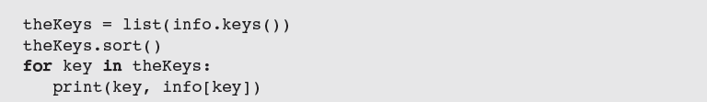
Traversing a Dictionary
To print all of the keys and their values:
Alternative: Use the dictionary method items()
Entries are represented as tuples within the list
You can sort the list first:

Slide 36
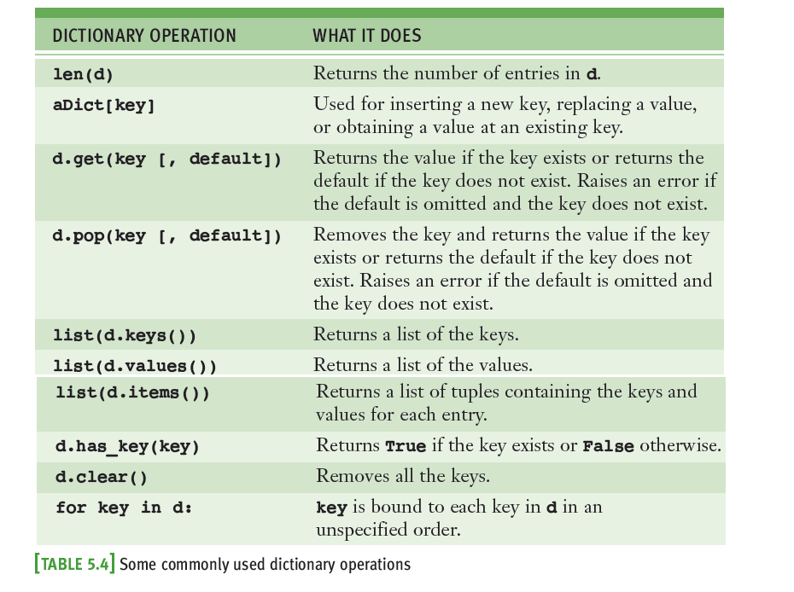
Traversing a Dictionary

Slide 37
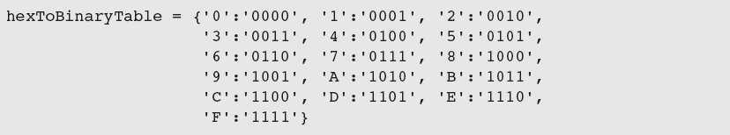
Example: The Hexadecimal System Revisited
You can keep a hex-to-binary lookup table to aid in the conversion process.
Read the code below. What does each line do?

Slide 38
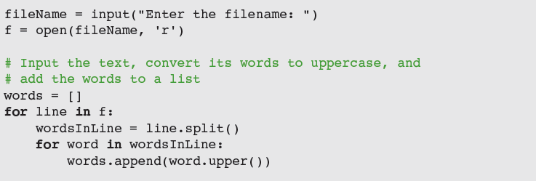
Example: Finding the Mode of a List of Values
The mode of a list of values is the value that occurs most frequently
The following script inputs a list of words from a text file and prints their mode

Slide 39
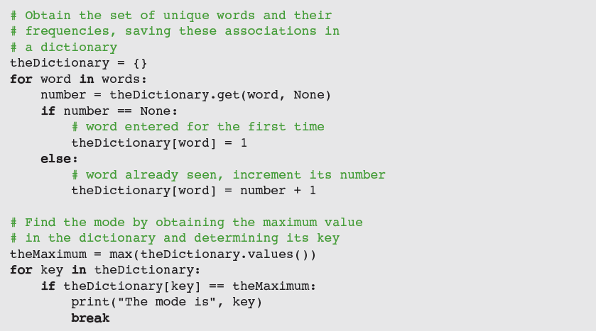
Example: Finding the Mode of a List of Values

Slide 40
Case Study: Nondirective Psychotherapy (Request)
Doctor in this kind of therapy responds to patient’s statements by rephrasing them or indirectly asking for more information
Request:
Write a program that emulates a nondirective psychotherapist

Slide 41
Case Study: Nondirective Psychotherapy (Analysis)

Slide 42
Case Study: Nondirective Psychotherapy (Analysis)
When user enters a statement, program responds in one of two ways:
With a randomly chosen hedge, such as “Please tell me more”
By changing some key words in user’s input string and appending string to a randomly chosen qualifier
Thus, to “My teacher always plays favorites,” program might reply, “Why do you say that your teacher always plays favorites?”

Slide 43
Case Study: Nondirective Psychotherapy (Design)
Program consists of a set of collaborating functions that share a common data pool
Pseudocode:
output a greeting to the patient
while True
prompt for and input a string from the patient
if the string equals “Quit”
output a sign-off message to the patient
break
call another function to obtain a reply to this string
output the reply to the patient

Slide 44
Case Study: Nondirective Psychotherapy (Implementation)

Slide 45
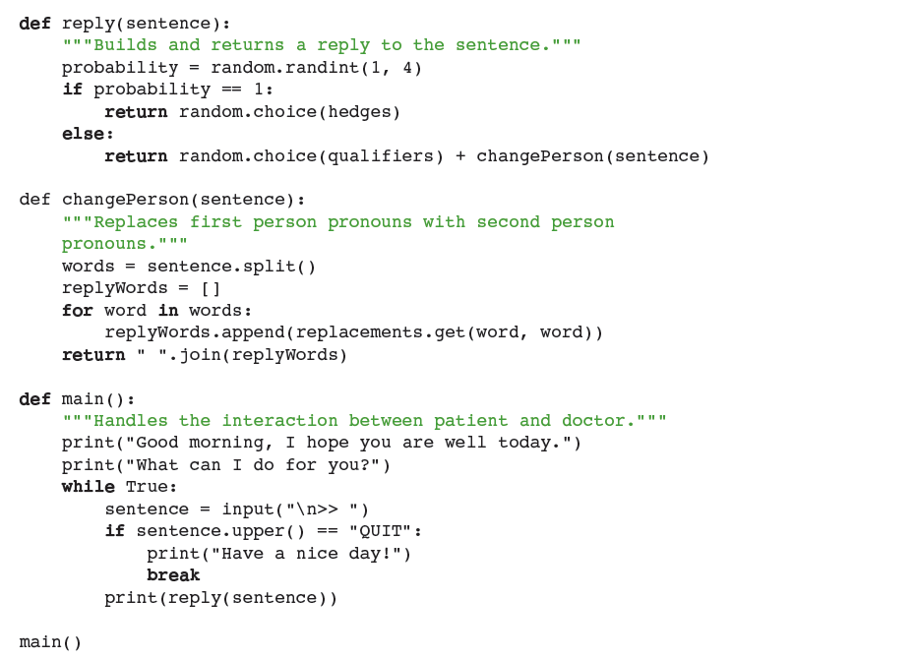
Case Study: Implementation

Slide 46
Case Study: Nondirective Psychotherapy (Testing)
Functions in this program can be tested in a bottom-up or a top-down manner
Program’s replies break down when:
User addresses the therapist in the second person
User uses contractions (for example, I’m and I’ll)
With a little work, you can make the replies more realistic

Slide 47
Summary
A list is a sequence of zero or more elements
Can be manipulated with the subscript, concatenation, comparison, and in operators
Mutable data structure
index returns position of target element in a list
Elements can be arranged in order using sort
Mutator methods are called to change the state of an object; usually return the value None
Assignment of a variable to another one causes both to refer to the same data object (aliasing)

Slide 48
Summary
A tuple is similar to a list, but is immutable
A function definition consists of header and body
return returns a value from a function definition
A dictionary associates a set of keys with values
[] is used to add a new key/value pair to a dictionary or to replace a value associated with an existing key
dict type includes methods to access and remove data in a dictionary
Testing can be bottom-up, top-down, or you can use a mix of both

